Slide 1

University Of Stirling
Privacy of the Internet
Keylogger
Constantinos Constantinou
CSCU9A1

Slide 2
What is a keylogger?
Most sources define a keylogger as a software program designed to secretly monitor and log all keystrokes. This definition is not completely correct, since a keylogger doesn’t have to be software, it can also be a device.

Slide 3
Why spywares exist?
Parental control: parents can secretly track what their children do on the Internet and with who are they talking to social media (Facebook, twitter etc.)
Companies: to monitor their employers if they are time-wasters, to prevent data theft/secrets and damage to business.
Cyber criminals: they can get PIN codes and bank account numbers for e-payment systems, passwords to online gaming accounts, email addresses, user names, email passwords etc.

Slide 4
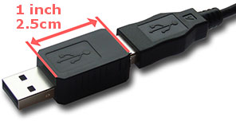
Hardware keylogger:
Two huge disadvantages of hardware keyloggers are:
Easy to detect.
The "attacker" must come back physically and take the this small USB connector.

Slide 5
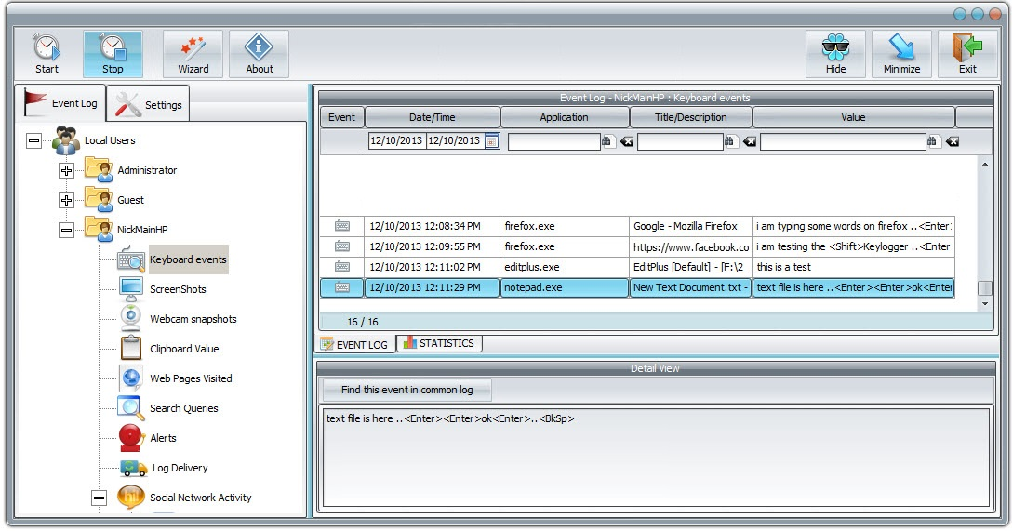
Software keylogger:

Slide 6
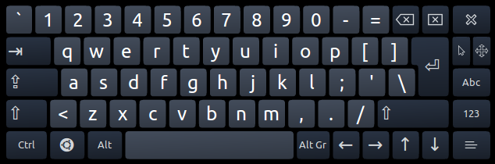
How can you protect your computer and your privacy?
Download software only from trustful websites
Don’t install any software if don’t know what it can do
Don’t click on links with questionable pop-up ads
Always keep the antivirus updated
Use one-time passwords or two-step authentication
Use a virtual keyboard in public computers
Avoid to make payments from public computers

Slide 7
Pros and Cons
Pros:
Parental Control
Company Productivity/Security
Other Security reasons
Cons:
Cyber Criminals
Every one can use it (free, friendly in use)
Not illegal (if it’s supposed to used for good but no one knows if it is the opposite)
It present NO threat to system if it is already installed
Either is used for good or bad purposes is still an invader into other people privacy.

